Slide 1

Department of Computer Science & Engineering Project Presentation
MILITANT INTRUSION DETECTION USING MACHINE LEARNING
Project Team
SRUJANA M R 1DB19CS143
SUPRITHA B R 1DB19CS147
SUSHMA PATIL 1DB19CS149
SUSHMITHA S 1DB19CS150
Guide
Prof. SHEEBA S
Assistant Professor
CSE Department
DBIT

Slide 2
INDEX
Introduction
Literature survey
Problem statement
Objectives
Abstract
Methodology
System Architecture
Implementation
Result
Conclusion
References

Slide 3
INTRODUCTION
Weapon or Anomaly detection is the identification of irregular, unexpected, unpredictable, unusual events or items, which is not considered as normally occurring events or regular items in a pattern or items present in a dataset and thus different from existing patterns.
An anomaly is a pattern that occurs differently from a set of standard patterns.
Object detection uses feature extraction and learning algorithms or models to recognize instances of various categories of objects.
Proposed implementation focuses on accurate gun detection and classification. Also concerned with accuracy, since a false alarm could result in adverse responses.

Slide 4
LITERATURE SURVEY
Anomaly Detection in Videos for Video Surveillance Applications using Neural Networks
Authors: Ruben J Franklin, Mohana, Vidyashree Dabbagol
Publications: Proceedings of the Fourth International Conference on Inventive Systems and Control (ICISC 2020) IEEE
Abstract: Anomaly detection in video surveillance involves breaking down the whole process into three layers, which are video labelers, image processing, and activity detection.

Slide 5
LITERATURE SURVEY
Visual detection of knives in security applications using Active Appearance Models
Authors: Andrzej Glowacz & Marcin Kmieć & Andrzej Dziech
Publications: Springer
Abstract: This paper presents a novel application of Active Appearance Models to detect knives in images. The work presented in this paper aims to create a robust visual knife-detector to be used in security applications.

Slide 6
LITERATURE SURVEY
Performance Analysis of Object Detection and Tracking Algorithms for Traffic Surveillance Applications using Neural Networks
Authors: Naman Jain, Shreesha Yerragolla, Tanuja Guha, Mohana
Publications: Proceedings of the Third International Conference on I-SMAC (IoT in Social, Mobile, Analytics, and Cloud) (I-SMAC 2019) IEEE
Abstract: It consists of 80 classes out of which five classes have been considered for this project which are: car, bus, truck, motorcycle, and train. Using the Multiple Object Detection concepts, tracking of vehicles was further implemented.

Slide 7
LITERATURE SURVEY
Scalable Object Detection using Deep Neural Networks
Authors: Dumitru Erhan, Christian Szegedy, Alexander Toshev, and Dragomir Anguelov
Publications: IEEE Conference on Computer Vision and Pattern Recognition
Abstract: In this work, we propose a saliency-inspired neural network model for detection, which predicts a set of class-agnostic bounding boxes along with a single score for each box, corresponding to its likelihood of containing any object of interest.

Slide 8
PROBLEM STATEMENT
In this project, we are going to develop a vision-based detection system that detects militant activities in surveillance areas with region based. For this purpose, we have employed deep learning in order to meet the requirements.

Slide 9
OBJECTIVE
Aim of the project is to implement the detection of intruders, guns, grenades, tankers, and militants using a YOLOv5(You Only Look Once) algorithm which is the base of CNN layers.
Collecting dataset as per the custom objects.
Preprocessing with the labeling of the image to create the region to train using Makesense.ai.
Creating the trained model using the Pytorch framework.
Send the alert message along with the frame where detection happens using TeleBot API.

Slide 10
ABSTRACT
The Proposed work is being used for surveillance, monitoring, and classifications of weapons, live tracking, and many more purposes. In this work, live surveillance videos are taken for monitoring and detecting abnormal events based on real-time image processing techniques. It also drastically reduces the crime rate and time required to catch criminals.
Operations of the proposed project have three processing modules:
The first processing module is for object detection using Convolutional Neural Networks(CNN).
The second processing module will handle the classification of weapons.
Monitoring and alarm operations will be carried out by the third processing module.

Slide 11
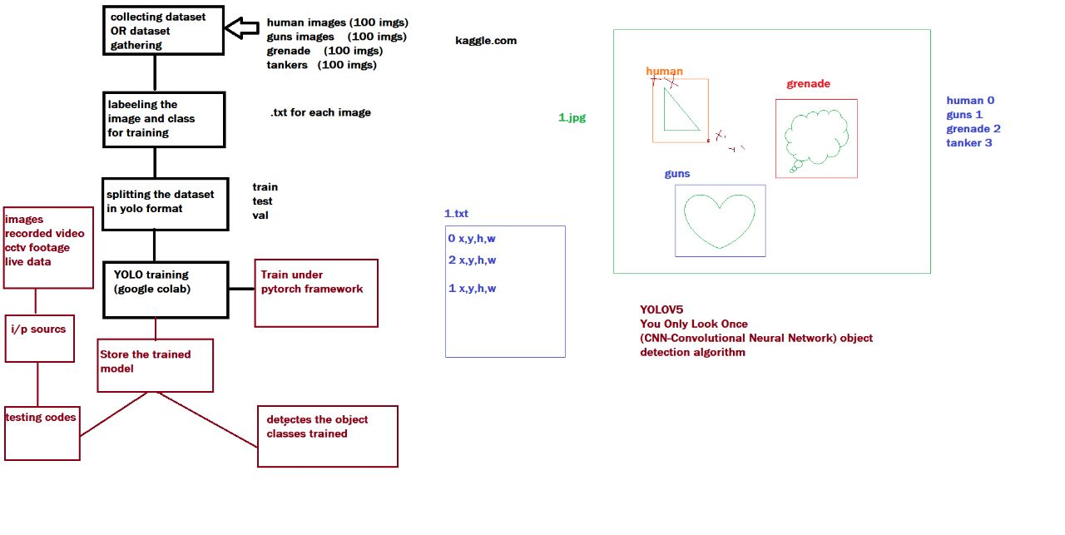
METHODOLOGY

Slide 12
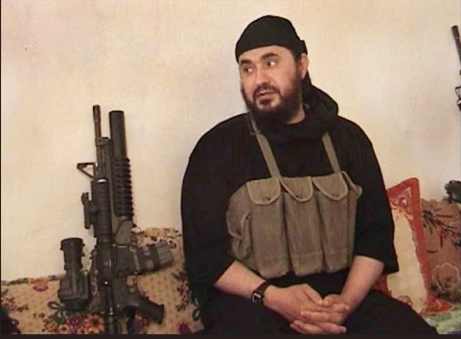
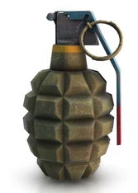
MILITANT VISUAL EXAMPLES

Slide 13

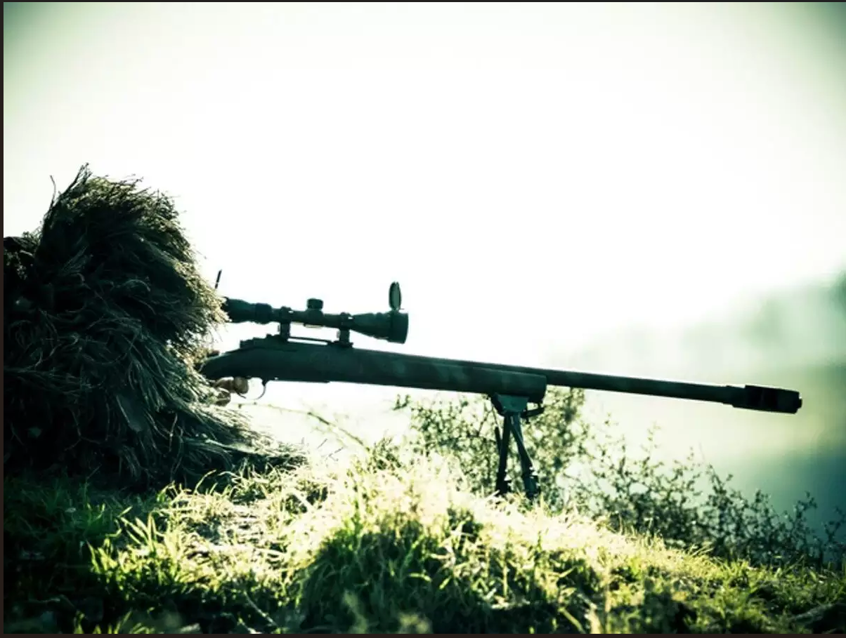
MILITANT VISUAL EXAMPLES

Slide 14
SYSTEM ARCHITECTURE
System architecture for Militant intrusion detection

Slide 15
SYSTEM ARCHITECTURE
STEPS IN WEAPON RECOGNITION :
Image Processing: Image processing is a mechanism that focuses on the manipulation of images in different ways in order to enhance the image quality.
Identification: In this stage identify the particular region of the image that is used for feature extraction and classification.
Feature Extraction: In this stage extract the required feature from the identified region which is obtained from the previous step.
Weapon Recognition: The output image obtained from feature extraction is given as input to this process and weapon is identified using artificial neural networks

Slide 16
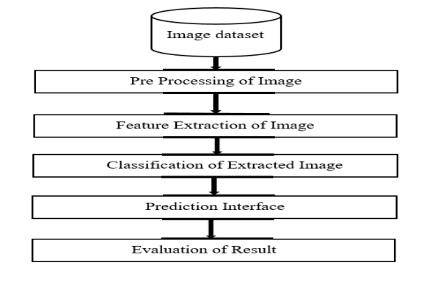
SYSTEM ARCHITECTURE
Block diagram for proposed system

Slide 17
SYSTEM ARCHITECTURE
STAGES IN PROJECT:
Data Collection and Dataset Preparation: Images can be downloaded from the Internet using the keywords hand gestures and sign language.
Training: In this step, training the deep convolutional neural network for making an image classification model will be done.
Video Acquisition: First step deals with acquiring the video by any one the devices, such as Handy Cam, Mobile Camera, USB camera and CCTV Camera etc.
Frame Conversion: Once the video is capture, those videos are converted into frames and suitable type of processing can be done conveniently.

Slide 18
SYSTEM ARCHITECTURE
Pre-Processing: Pre-processing is applied on the frames of the video to reduce the noise. some of the common methods of pre-processing are smooth, dilate, erode and median etc.
Background Modelling: Once the pre-processing is done, background modelling is used to create an ideal background (static or dynamic) according to the environmental changes.
Background Subtraction: In this step any significant changes in the image region from background model are identified & then pixels constituting the regions undergoing change are marked for further processing.

Slide 19
SYSTEM ARCHITECTURE
Post-Processing: Finally, post-processing is done to improve the results or to improve foreground mask.
Foreground Extraction: This is the final step in the process which extracts the moving object from the frame.

Slide 20
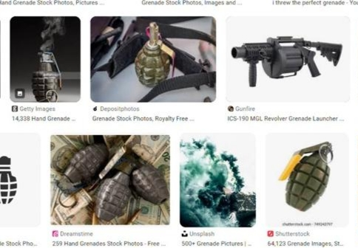
IMPLEMENTATION
STAGES IN INMPLENTATION:
Image Collection and Dataset Preparation: Images can be downloaded from the Internet using image downloader.

Slide 21
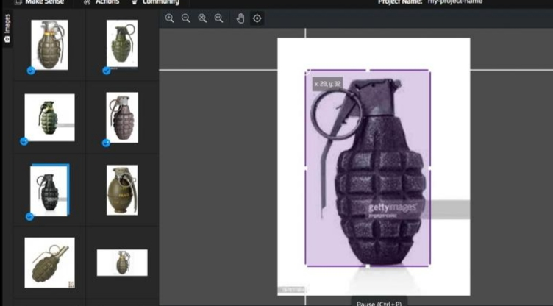
IMPLEMENTATION
Resize Images: In this step all the collected images are resized and placed in the class grenade using MAKESENSE.ai

Slide 22
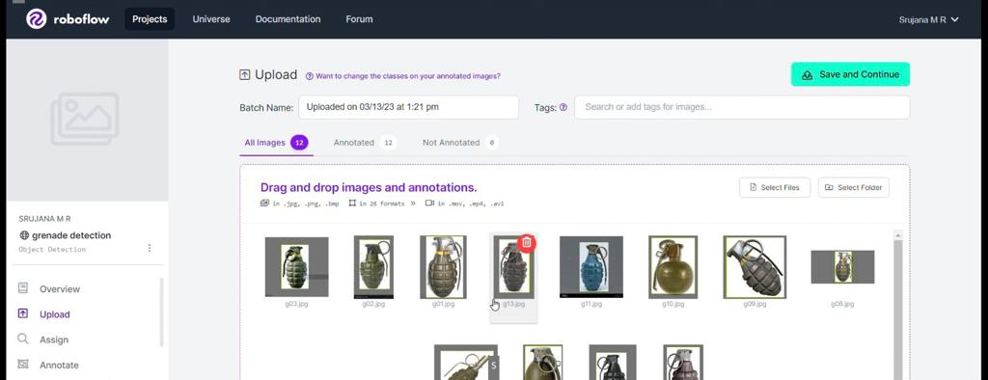
IMPLEMENTATION
Creating Bounding Boxes: In order to create bounding boxes, drag and drop all the collected images inside the Roboflow.

Slide 23
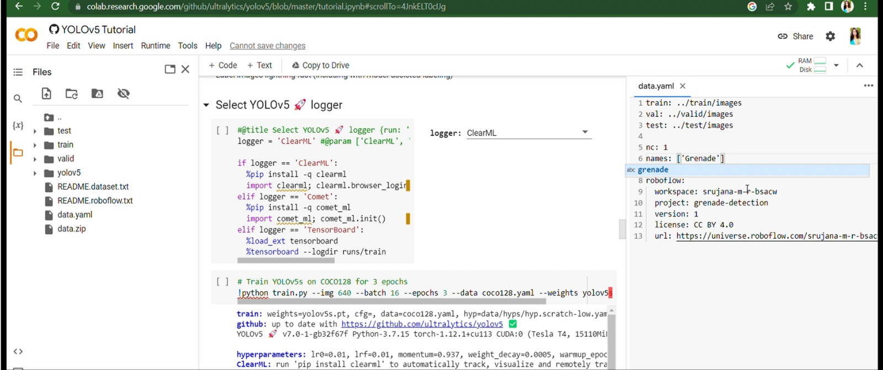
IMPLEMENTATION
Connection with GitHub: Connect with the collab server in the github which contains the requirement set of files with the packages to run the program.

Slide 24
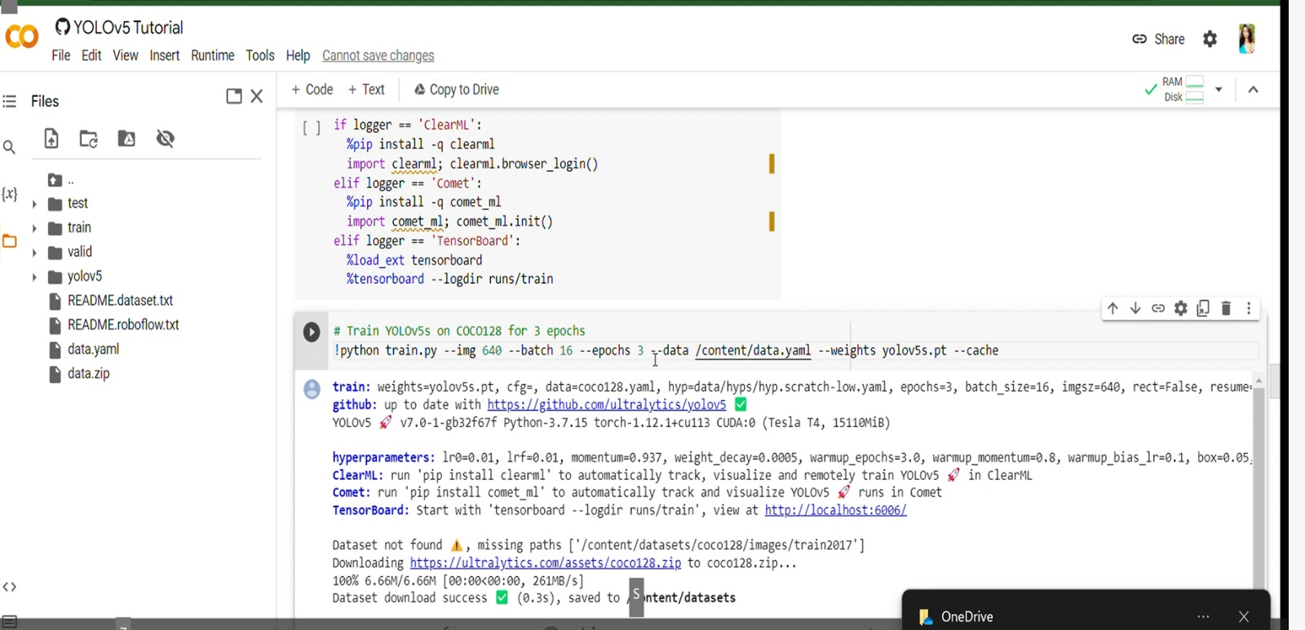
IMPLEMENTATION
Model Training:
Change the path to the training dataset path.
Model will be trained using logger.
Training period depends on the amount of images we have taken.

Slide 25
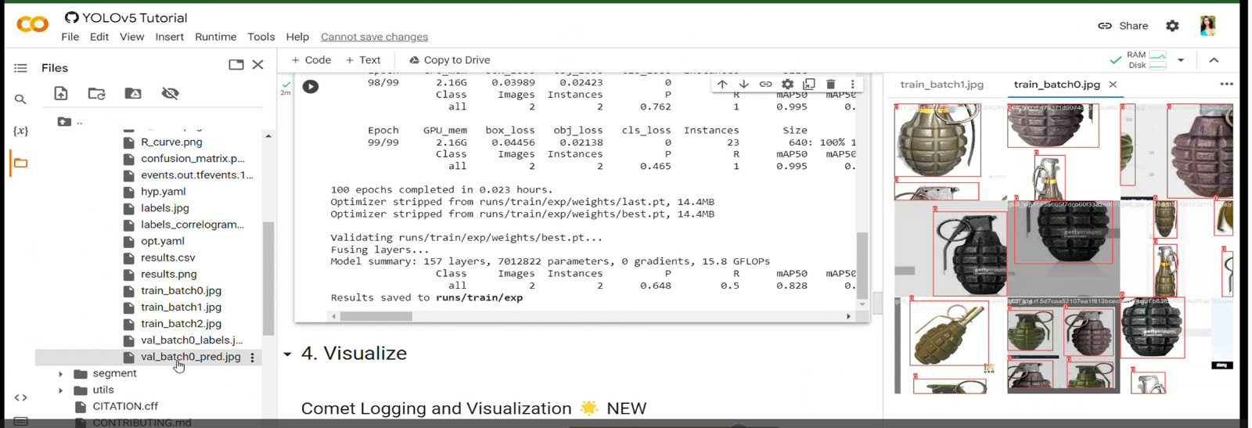
IMPLEMENTATION
Training Process and Result: Objects are detected and shown along with accuracy.

Slide 26
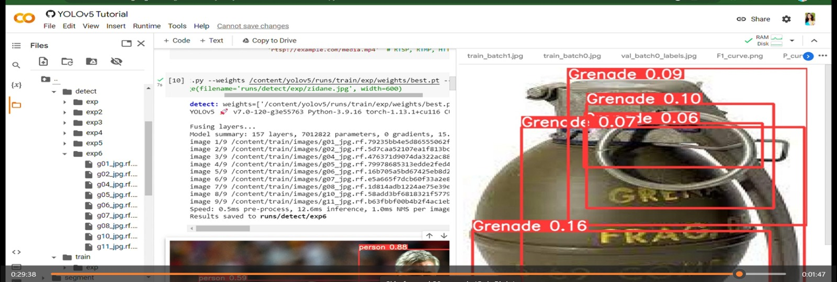
RESULT

Slide 27
CONCLUSION
The results of the project have been satisfactory, and the identification and classification of weapons and militant detection are high.
The pre-processing steps used to reduce the amount of data input during the classification have been proven to be useful as the information contained in weapon and militant images.
The development of these subsystems has accomplished the objective of using only the significant data: the pixels around the regions that might be weapons and militants based on the pixel’s intensity.
The processes of rotation and translation of the images have allowed them to obtain many examples of weapons and militants to train CNN to learn from them.
The image dataset was labeled manually using YOLOv5 for image detection.

Slide 28
REFERENCES
[1] Ruben J Franklin, Mohana, and Vidyashree Dabbagol, “Anomaly Detection in Videos for Video Surveillance Applications using Neural Networks,” publication is on Proceedings of the Fourth International Conference on Inventive Systems and Control (ICISC 2020) IEEE.
[2] Andrzej Glowacz, Marcin Kmiec, and Andrzej Dziech, “Visual detection of knives in security applications using Active Appearance Models,” publication is on Springer.
[3] Naman Jain, Shreesha Yerragolla, Tanuja Guha, and Mohana, “Performance Analysis of Object Detection and Tracking Algorithms for TrafficSurveillance Applications using Neural Networks,” publication is on proceedings of the Third International Conference on I-SMAC (IoT in Social, Mobile, Analytics, and Cloud) (I-SMAC 2019) IEEE.

Slide 29
REFERENCES
[4] Dumitru Erhan, Christian Szegedy, Alexander Toshev, and Dragomir Anguelov, “Scalable Object Detection Using Deep Neural Networks,” publication is on IEEE Conference on Computer Vision and Pattern Recognition.

Slide 30


